Slide 1
Space Invaders
By: Nate Turkington

Slide 2
Goals
Movement from left to right for the player
Create lasers that come out of the players spaceship to hit the enemies
Movement from enemies to go to the side to the boundary and as they hit go down and to the other side boundary

Slide 3
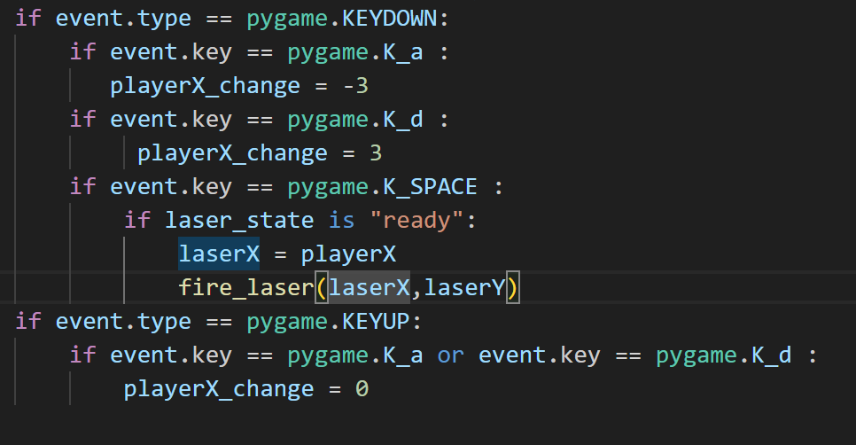
Notes:
This code listens for keyboard actions. It responds to the 'a' and 'd' keys to move the player character left and right, respectively. The spacebar is used to fire a laser, but it checks if the laser state is "ready" before doing so. When the 'a' or 'd' keys are released, the horizontal movement for the player character is stopped.

Slide 4
